Slide 1
more for loops.
Week 3 | Lecture 2 (3.2.2)
While waiting for class to start:
Download and open the Jupyter Notebook (.ipynb) for Lecture 3.2.2
You may also use this lecture’s JupyterHub link instead (although opening it locally is encouraged).
Upcoming:
Reflection 3 released Friday @ 11 AM
Lab 3 deadline this Friday @ 11 PM
PRA (Lab) on Friday @ 2PM this week (ONLINE)
Midterm - May 31 in lecture @ 9:10 AM

Slide 2
Today’s Content
Lecture 3.2.1
for loops
Lecture 3.2.2
for loops on indices, nested loops

Slide 3
for loops
name = ‘Sebastian’
for character in name:
print(character)
Output:
S
e
b
a
s
t
i
a
n
A for loop starts with the keyword for.

Slide 4
for loops
name = ‘Sebastian’
for character in name:
print(character)
for item1, item2 in iterable:
do something.
Next, we provide the name of one of more variables.
We have called the variable character, but you can call it whatever you like as long as it follows rules for naming a variable.

Slide 5
for loops
name = ‘Sebastian’
for character in name:
print(character)
Output:
S
e
b
a
s
t
i
a
n
Our variable character will be bound to each of the items in the sequence in turn.

Slide 6
for loops
name = ‘Sebastian’
for character in name:
print(character)
Output:
S
e
b
a
s
t
i
a
n
Specify what the values are in.
What is the iterable?
An iterable is an object that can be iterated over.
Strings are iterable (we know these from last week).
Lists (next week) are iterable.

Slide 7
for loops
name = ‘Sebastian’
for character in name:
print(character)
Output:
S
e
b
a
s
t
i
a
n
As with the while loop, the for loop statement ends with a colon.
This is how Python knows you are going to create a new block of code.

Slide 8
for loops
name = ‘Sebastian’
for character in name:
print(character)
Output:
S
e
b
a
s
t
i
a
n
Indenting four spaces tells Python what lines of code are in that block you want to repeated.
Indent

Slide 9
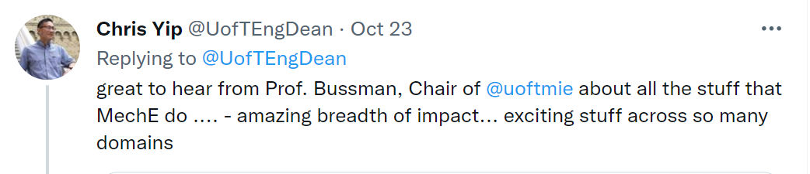
Breakout Session 1
We want to do some analysis of Dean Yip’s Tweets.
Before we can do this, we’ll need to make the tweet all lower case and replace all the punctuations with white space.
‘impact... Exciting’ → ‘impact exciting‘
Open your notebook
Click Link:
1. Breakout Session 1

Slide 10
Today’s Content
Looping through indices with a for loop.
Nested for loops.

Slide 11
Looping Through Indices
Last lecture we saw that we can use while loops to loop over the indices of a string.
Then we saw that a for-loop requires less code but it iterates over the values, not the indices.
while
for
i = 0
while i < len(chrome_4):
print(i, chrome_4[i])
i += 1
for character in chrome_4:
print(character)

Slide 12
Looping Through Indices
Can we use a for loop to loop over indices?
while
for
i = 0
while i < len(chrome_4):
print(i, chrome_4[i])
i += 1
for character in chrome_4:
print(character)

Slide 13
Looping on a range()
Python has a built-in function called range() that can be used to generate a sequence of numbers. The general syntax of range is as follows:
Similar to the string slicing syntax:
The stop value is not included in the sequence of numbers generated.
Can omit start and step which will result in default values being used. range(n) → range(0, n, 1)
range(start, stop, step)

Slide 14
Looping on a range()
range() is typically used in a for loop to iterate over a sequence of numbers.
range() is an iterable.
Open your notebook
Click Link:
2. Using range()
This thing has to be an iterable.
for i in range(5):
print(i)

Slide 15
Breakout Session 2
Add up all the even numbers between 1 and 100 using a for loop and range().
2+4+…..+96+98+100
Open your notebook
Click Link:
3. Breakout Session 2

Slide 16
Breakout Session 3
Write a function that returns the number of times that a character and the next character are the same.
If you have a bug in a loop, with probability ~1 its an off-by-one index error.
Open your notebook
Click Link:
4. Breakout Session 3
count_adjacent_repeats('abccdeffggh’)
>>> 3

Slide 17
Nested for Loops
for item in iterable:
do something.
The bodies of loops can contain any statement, including other loops!
When this occurs, it is known as a nested loop.
for i in range(10, 13):
for j in range(1, 5):
print(i, j)
Output
10, 1
10, 2
10, 3
…

Slide 18
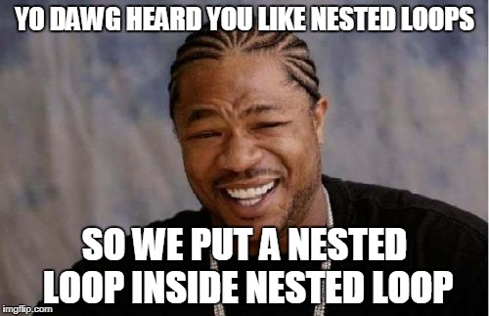
Nested for Loops
The bodies of loops can contain any statement, including other loops!
When this occurs, it is known as a nested loop.
Open your notebook
Click Link:
5. Nested for Loops

Slide 19
Lecture Recap
The general form of a for loops.
Iterable types have indices and items.
For loops always iterate over the items in the iterable variable.
Using range(start, end, step) we can keep track of where we are in a sequence (i.e. index).
for item in iterable:
do something.

Slide 20
more for loops.
Week 3 | Lecture 2 (3.2.2)

